Slide 1
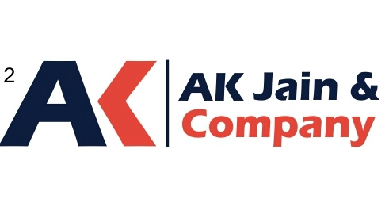
MUTUAL FUND
AN INITIATIVE BY A.K. JAIN & CO.

Slide 2
WHAT IS A MUTUAL FUND ?
A mutual fund is a pool of money from numerous investors who wish to save or make money just like you. Investing in a mutual fund can be a lot easier than buying and selling individual stocks and bonds on your own. Investors can sell their shares when they want.
Professional Management. Each fund's investments are chosen and monitored by qualified professionals who use this money to create a portfolio. That portfolio could consist of stocks, bonds, money market instruments or a combination of those.
Fund Ownership. As an investor, you own shares of the mutual fund, not the individual securities. Mutual funds permit you to invest small amounts of money, however much you would like, but even so, you can benefit from being involved in a large pool of cash invested by other people. All shareholders share in the fund' s gains and losses on an equal basis, proportionately to the amount they've invested.
A.K. JAIN & CO.

Slide 3
DIVERSIFICATION IN MUTUAL FUND
By investing in mutual funds, you could diversify your portfolio across a large number of securities so as to minimise risk. By spreading your money over numerous securities, which is what a mutual fund does, you need not worry about the fluctuation of the individual securities in the fund's portfolio.
A.K. JAIN & CO.

Slide 4
PRINCIPLE OBJECTIVES
There are many different types of mutual funds, each with its own set of goals. The investment objective is the goal that the fund manager sets for the mutual fund when deciding which stocks and bonds should be in the fund's portfolio.
For example, an objective of a growth stock fund might be: This fund invests primarily in the equity markets with the objective of providing long-term capital appreciation towards meeting your long-term financial needs such as retirement or a child' s education.
A.K. JAIN & CO.

Slide 5
Depending on investment objectives, funds can be broadly classified in the following 5 types - :
Aggressive growth means that you will be buying into stocks which have a chance for dramatic growth and may gain value rapidly. This type of investing carries a high element of risk with it since stocks with dramatic price appreciation potential often lose value quickly during downturns in the economy. It is a great option for investors who do not need their money within the next five years, but have a more long-term perspective. Do not choose this option when you are looking to conserve capital but rather when you can afford to potentially lose the value of your investment.
A.K. JAIN & CO.

Slide 6
As with aggressive growth, growth seeks to achieve high returns; however, the portfolios will consist of a mixture of large-, medium- and small-sized companies. The fund portfolio chooses to invest in stable, well established, blue-chip companies together with a small portion in small and new businesses. The fund manager will pick, growth stocks which will use their profits grow, rather than to pay out dividends. It is a medium - long-term commitment, however, looking at past figures, sticking to growth funds for the long-term will almost always benefit you. They will be relatively volatile over the years so you need to be able to assume some risk and be patient.
A combination of growth and income funds, also known as balanced funds, are those that have a mix of goals. They seek to provide investors with current income while still offering the potential for growth. Some funds buy stocks and bonds so that the portfolio will generate income whilst still keeping ahead of inflation. They are able to achieve multiple objectives which may be exactly what you are looking for. Equities provide the growth potential, while the exposure to fixed income securities provide stability to the portfolio during volatile times in the equity markets. Growth and income funds have a low-to-moderate stability along with a moderate potential for current income and growth. You need to be able to assume some risk to be comfortable with this type of fund objective.
A.K. JAIN & CO.

Slide 7
That brings us to income funds. These funds will generally invest in a number of fixed-income securities. This will provide you with regular income. Retired investors could benefit from this type of fund because they would receive regular dividends. The fund manager will choose to buy debentures, company fixed deposits etc. in order to provide you with a steady income. Even though this is a stable option, it does not go without some risk. As interest-rates go up or down, the prices of income fund shares, particularly bonds, will move in the opposite direction. This makes income funds interest rate sensitive. Some conservative bond funds may not even be able to maintain your investments' buying power due to inflation.
The most cautious investor should opt for the money market mutual fund which aims at maintaining capital preservation. The word preservation already indicates that gains will not be an option even though the interest rates given on money market mutual funds could be higher than that of bank deposits. These funds will pose very little risk but will also not protect your initial investments' buying power. Inflation will eat up the buying power over the years when your money is not keeping up with inflation rates. They are, however, highly liquid so you would always be able to alter your investment strategy.
A.K. JAIN & CO.

Slide 8
GETTING STARTED WITH MUTUAL FUNDS
People have different investment needs depending on their financial goals, tolerance for risk and time frame—when they need the money they invested.
Our mutual funds are created with these needs in mind-we start with you. Before you choose investments, think about your financial goals, risk tolerance and time frame. Then choose investments that match them. For more information about these topics, see the Relevant Links box to the right.
A.K. JAIN & CO.

Slide 9
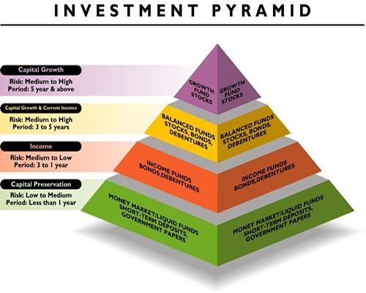
INVESTMENT PYRAMID
At AK JAIN & CO. we offer a wide variety of mutual fund options to meet the equally wide variety of investment needs of our investors. The investment pyramid below shows fund categories that are suitable for different time frames, with the longest time frames at the top and the shortest at the base of the pyramid.
A.K. JAIN & CO.

Slide 10
Investment experts recommend growth investments such as stocks and stock funds for long-term goals, where you won t need to sell your investment for 5 years or more. For short-term goals, where you might sell your investment in 1 year or less, they recommend fixed income funds and other liquid investments. Of course , their specific recommendations will depend on your comfort with risk.
A.K. JAIN & CO.

Slide 11
BENEFITS OF MUTUAL FUNDS
Stocks, bonds, money market instruments-as an investor, you have a wide variety of choices, and it would be difficult to find one type of investment vehicle that effectively takes advantage of all of to day investment options. That's why you may want to consider diversifying your portfolio over a variety of investment vehicles as mutual funds do for you.
In addition to providing you with the flexibility to create an investment plan based on your individual goals, mutual funds offer many other advantages such as professional management, affordability and diversification.
A.K. JAIN & CO.

Slide 12
IMPORTANCE OF AN ADVISOR
With the variety of investment options available today, we suggest that you seek guidance from a financial advisor. Nearly every investment entails special risks that should be discussed with an experienced professional. Your investment goals are unique, and an advisor can help you find the right fund to match your needs.
When taking a full-service approach to investing, you put a professional's training, knowledge, expertise and resources to work for you. Consider these benefits:
Potential access to important investment news when it is most valuable
Professional advice that may help improve your investment results
Expert help in determining the best way to allocate your assets
A trained and objective professional who can help you avoid panic selling
A.K. JAIN & CO.

Slide 13
You may be thinking that the Internet and financial planning software can cater to all these needs, but although they are convenient tools, they cannot equal the personal attention and experience of a professional. He or she can make that difference in helping you manage your financial future.
What to Expect From a Financial Advisor
The key for mutual fund investors is to define and recognise the value of professional financial services, and then insist on getting that value. When you pay a sales charge or a fee, what can you expect a professional to do for you? Your advisor should at least:
Understand your needs and help you formulate long-term investment goals and objectives. Before making specific recommendations, your advisor should try to gain a whole picture of your past experience, lifestyle and goals, as well as your other investments and current financial situation. When are you planning to retire, for example? Do you have life insurance? Do you own real estate? How secure is your job?
Help you develop realistic expectations by discussing the risks and rewards of each investment. Every investment choice has its strengths and weaknesses, and you should never feel less than fully informed. When you ask questions, or have doubts, you should expect your financial advisor to answer honestly, and help you develop a strategy that is both realistic and comfortable for you.
A.K. JAIN & CO.

Slide 14
Match your goals and objectives with appropriate mutual funds. You should expect your advisor to make clear and specific recommendations, and explain the reasons behind them in terms you can understand. Of course, the advisor should be confident and well informed about the management and portfolio strategies of any mutual funds recommended.
Continually monitor your portfolio and help you interpret performance. Your advisor cannot influence or predict a fund's results. However, he or she should discuss results with you and help you judge your progress. You should feel that you can always ask your advisor, "How am I doing?"
Conduct regular reviews to ensure that your strategy continues to provide optimal results for you. One of the most valuable services your advisor can provide is to help you "stay on course" with your investment program. But "staying on course" long term does not necessarily mean staying put. Expect your financial advisor to work with you to adjust your portfolio in response to any significant change in your lifestyle, priorities, assets or responsibilities.
A.K. JAIN & CO.

Slide 15
These are the basic services that investors should expect from their financial advisors. Beyond the basics, many investors could use even more specialised assistance, like advice on retirement plan distribution options, setting up and servicing retirement plans for small businesses and self-employed individuals, developing tax-advantaged strategies for children's college education, insurance, estate, and trust planning; and year-end mutual fund tax advice. If you need specialised services, there are many financial advisors who can help you obtain the help you need.
A.K. JAIN & CO.

Slide 16
IMPORTANT INFORMATION
Mutual funds investments are subject to market risks . Please read all scheme related documents carefully before investing.

Slide 17
PLEASE FEEL FREE TO CONTACT FOR ANY INVESTMENT RELATED QUERY
ADVISOR - MR. A.K. JAIN
PHONE - +91 9312210112
EMAIL - ashokneena@hotmail.com
WEBSITE - www.akjaininvestments.com
A.K. JAIN & CO.

Slide 18
THANK YOU
THANK YOU
A.K. JAIN & CO.

